Slide 1

Course Mechanics
CS 418: Interactive Computer Graphics
Professor Eric Shaffer

Slide 2
CS 418…About the Course
Interactive Computer Graphics
Focus on algorithms and techniques used in rasterization
Rasterization is fast enough for real-time complex 3D rendering
The course will teach you how to use WebGL
Web-based rasterization engine
Similar features to many other technologies (e.g. OpenGL, Vulkan, D3D)
We will also cover fundamental graphics algorithms
Things like line drawing that reside inside the WebGL library

Slide 3
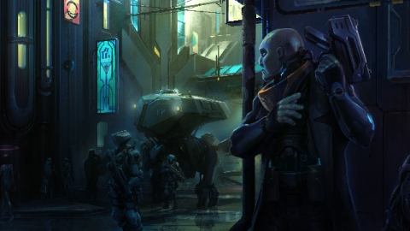

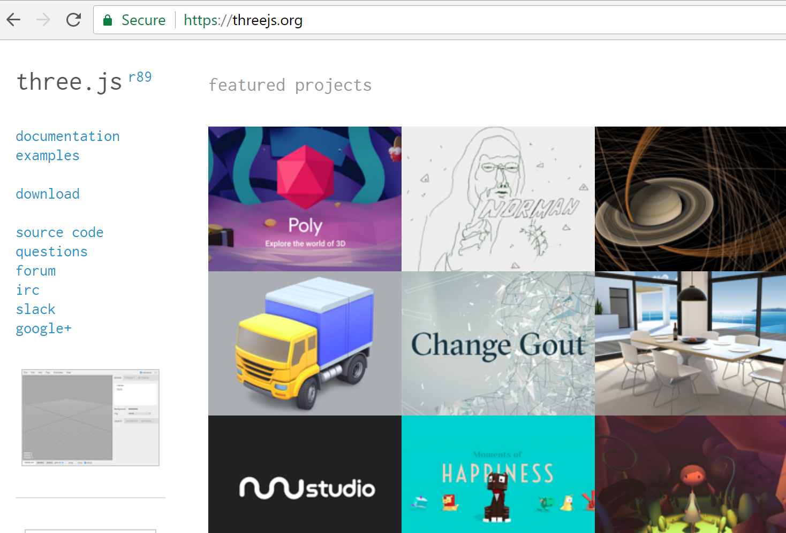
Things you would not use WebGL for..
Making a Game
Typically would use a game engine like Unity or Unreal
Making a Movie
Renderman
3D Web App Development
three.js which is built on WebGL
But to use three.js you need to understand WebGL
And, basic CG concepts need to be understood to use Unity or Renderman as well…

Slide 4
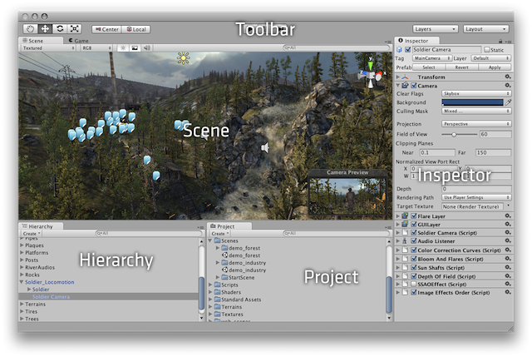
So Why Use WebGL?
Course goal: understand how graphics works at a fundamental level
…it’s not limited to training on application dev in Unity, for example
The fundamemtal concepts remain at higher levels
Unity dev interface

Slide 5
Class Mechanics
Course Website: https://courses.engr.illinois.edu/cs418
Schedule, lecture materials, assignments
Piazza: This term we will be using Piazza for class discussions https://piazza.com/illinois/fall2020/cs418/home.
Grades available on Compass
MP submission on Compass

Slide 6
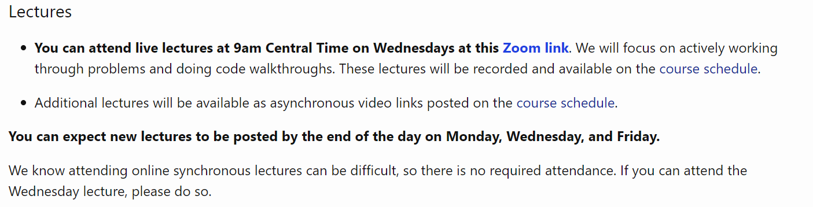
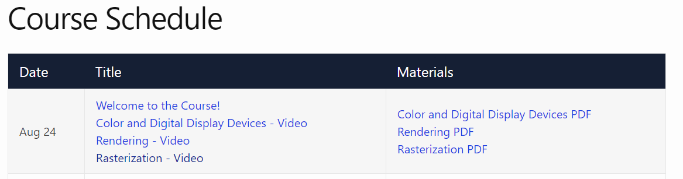
Lectures
https://illinois-cs418.github.io/schedule

Slide 7
Things we aren’t doing….
No Final Exam

Slide 8
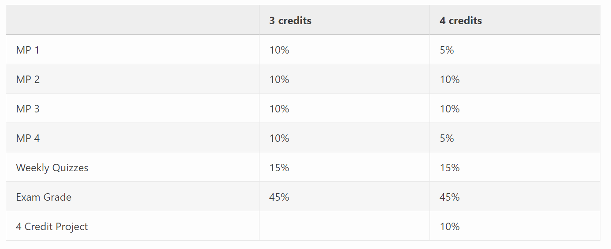
Things we are doing

Slide 9

Exams

Slide 10
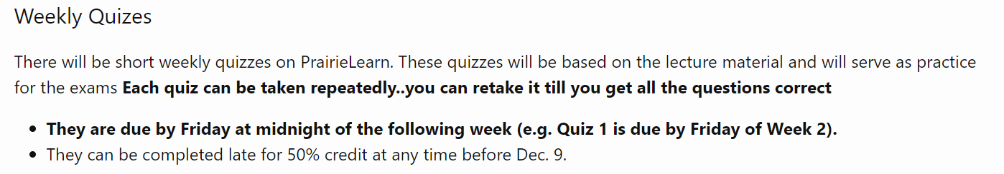
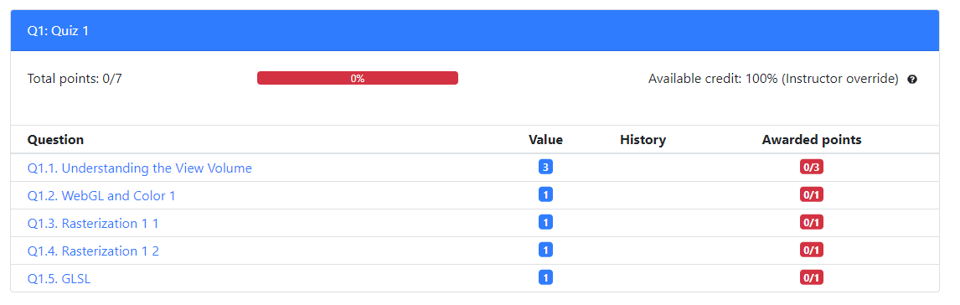
Quizzes
https://prairielearn.engr.illinois.edu/

Slide 11
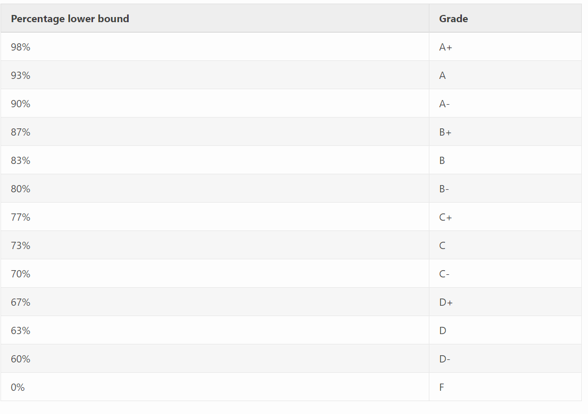
Grading Scale

Slide 12
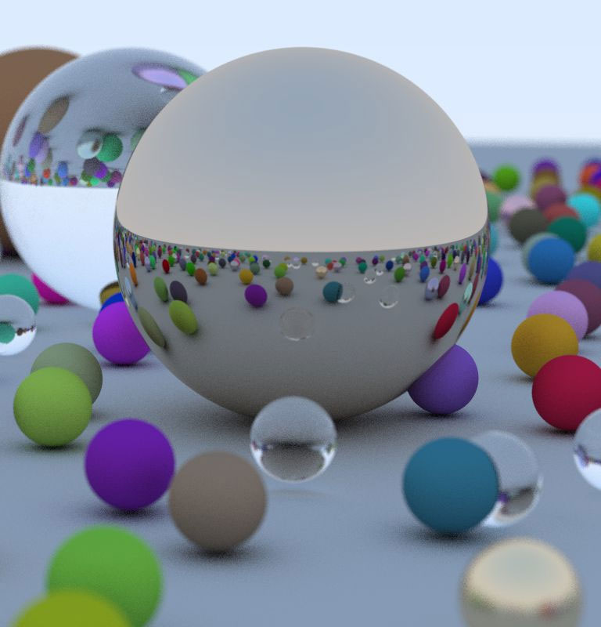

4 Credit Students
https://illinois-cs418.github.io/assignments/fourCreditMP.html

Slide 13
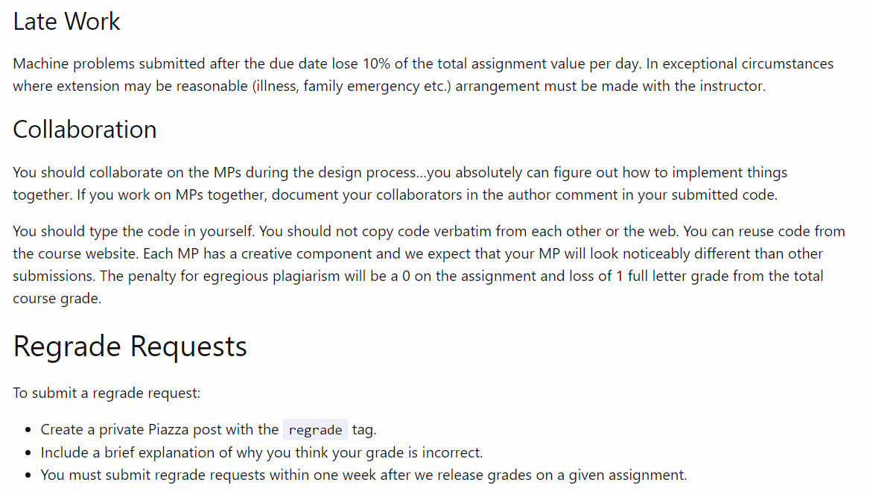
Course Policies
https://illinois-cs418.github.io/assignments

Slide 14
Class Mechanics: No Book
Language References and Resources
JavaScript/HTML/CSS: https://developer.mozilla.org/en-US/docs/Web/JavaScript
WebGL Specification: https://www.khronos.org/webgl/
WebGL Tutorial: https://developer.mozilla.org/en-US/docs/Web/API/WebGL_API
Suggested Editors: Brackets
Chrome DevTools Overview: https://developer.chrome.com/devtools

Slide 15
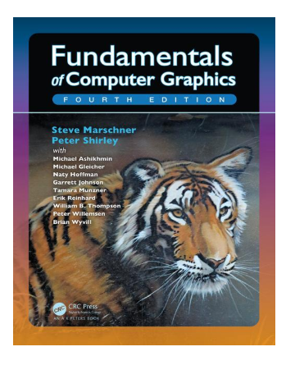
Suggested Books
Fundamentals of Computer Graphics 4th Edition by Steve Marschner, Peter Shirley Deals with the theoretical and mathematical aspects of computer graphics. Very readable. UIUC Library E-book link

Slide 16
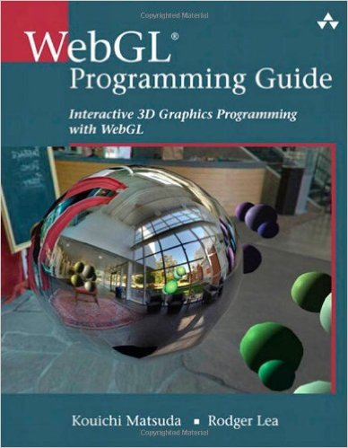
Suggested Books
WebGL Programming Guide: Interactive 3D Graphics Programming with WebGL (OpenGL)Jul 19, 2013
by Kouichi Matsuda and Rodger Lea

Slide 17
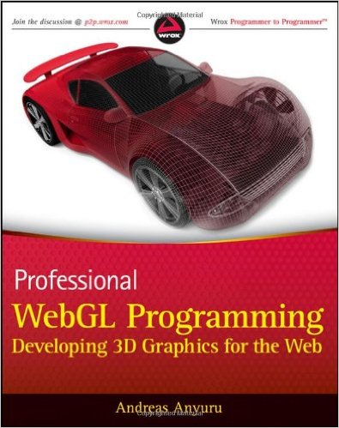
Suggested Books
Professional WebGL Programming: Developing 3D Graphics for the Web May 8, 2012
by Andreas Anyuru

Slide 18
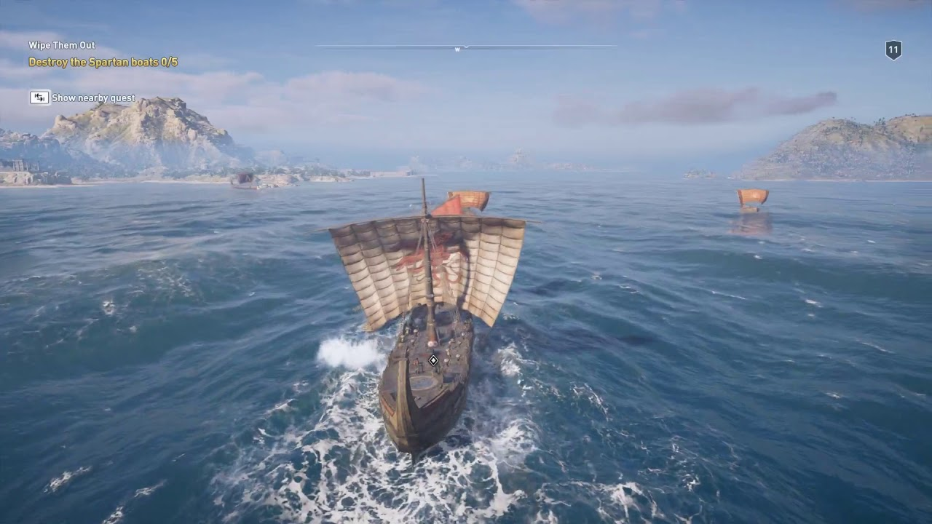
Course Topics
IMAGING — how do computers store images?
GEOMETRY — how do we represent shape?
RENDERING — how do we simulate light?
ANIMATION — how do we synthesize motion?

Slide 19
Some WebGL
https://artsexperiments.withgoogle.com/bagan
https://paveldogreat.github.io/WebGL-Fluid-Simulation/
http://david.li/fluid/

Slide 20

We will start with

Slide 21
For Next Class
If you have a laptop or your own PC
Install an editor (e.g. Brackets)
Install a browser supporting WebGL (e.g. Chrome)
Verify WebGL runs in that browser on your machine https://illinois-cs418.github.io/Examples/HelloColor.html https://illinois-cs418.github.io/Examples/HelloColor.js
Try changing the code…different color…different shape

